Slide 1
Project 421
Group 6:
Hana Hanifah, Haley Brittman, Jaynish Patel, Adrian Wenzen, Shubhankar Mishra
1

Slide 2
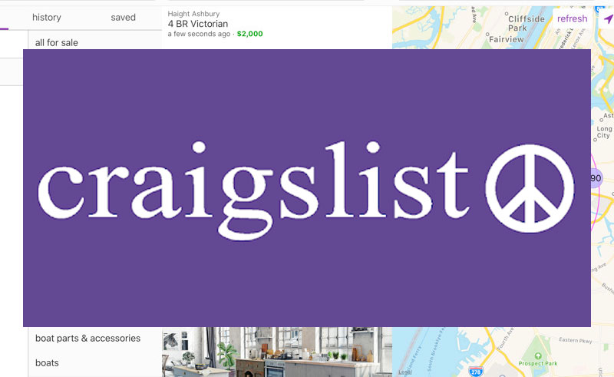
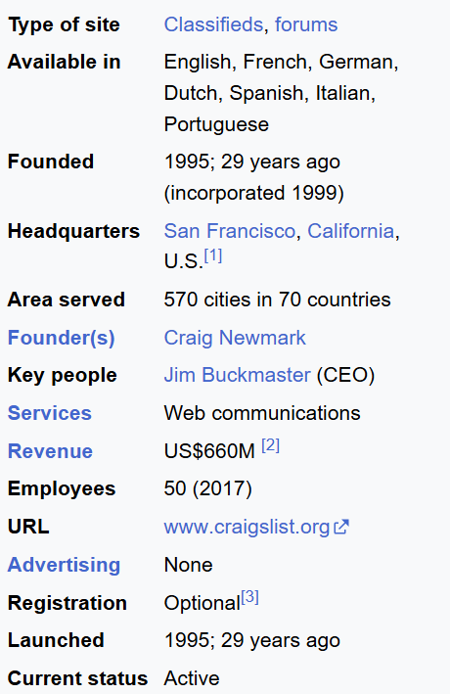
Introduction
2

Slide 3
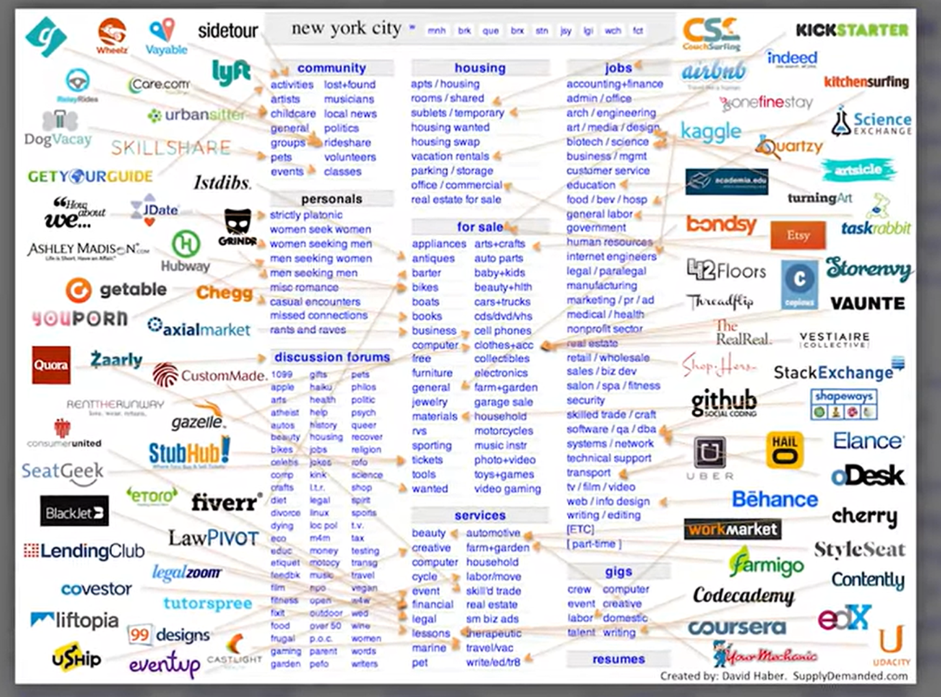


Introduction
3

Slide 4
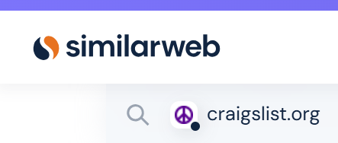
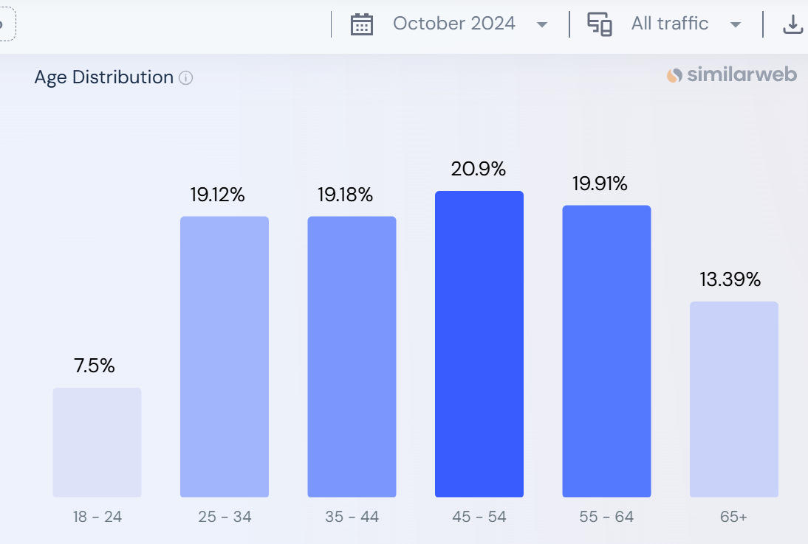

Introduction
Student typically use Craigslist to find apartment
4

Slide 5
Research Question
How do students navigate and interact with the Chicago Craigslist website, and what design improvements can enhance their user experience while maintaining the platform's simplicity and core appeal?
5

Slide 6
UX Methods - Focus Group Discussion(FGD)
The reason is:
Interaction among participants
Flexibility in asking questions based on the response
Participants has more room to explain their answer
We ask questions around the theme:
User familiarity of the site
How user navigate the site
Search bar functioning and accuracy
Site layout and adaptability
Recommendation
6
Notes:
Add questions example that you asked during the FGD

Slide 7
UX Methods - Focus Group Discussion(FGD)
The FGD was done via Google meeting at November 27, 2024, 7PM.
3 participants (College students)
Opening & Introduction
Verbal Informed Consent
Discussion
Summary & Conclusion
The moderator introduce himself and explain the purpose of this study
Moderator let the participants knows that this data of this study will only use for class assignment and will not published anywhere else
Moderator start the discussion by asking the first questions and encourage the participant to answer and discuss. Then moderator will move to the next questions once all participants done with their response.
Moderator summarize the discussion and thanks for the participation of the participants.
7
Notes:
Add questions example that you asked during the FGD

Slide 8
Results
The FGD conducted with the three participants representing varying levels of familiarity with the site, provided valuable insights into user experiences and perceptions. Those include but are not limited to: -
The filtering system got high praises for fast and accurate searches.
Users liked the site's ease of navigation but noted that its text-heavy approach and dated look dampened their experience.
Participants expressed the need for better handling of partial matches and misspellings to improve accuracy.
Participants suggested that a more streamlined mobile experience would enhance usability.
The site's design appeared overly simplistic and lacked modern visual elements.
8

Slide 9
Results
The main areas of Interest where we felt requires the most focus on are below: -
Ease of Use
And Functionality
Visual Design
Search Accuracy
Device Responsiveness
9

Slide 10
Proposed Changes

Slide 11
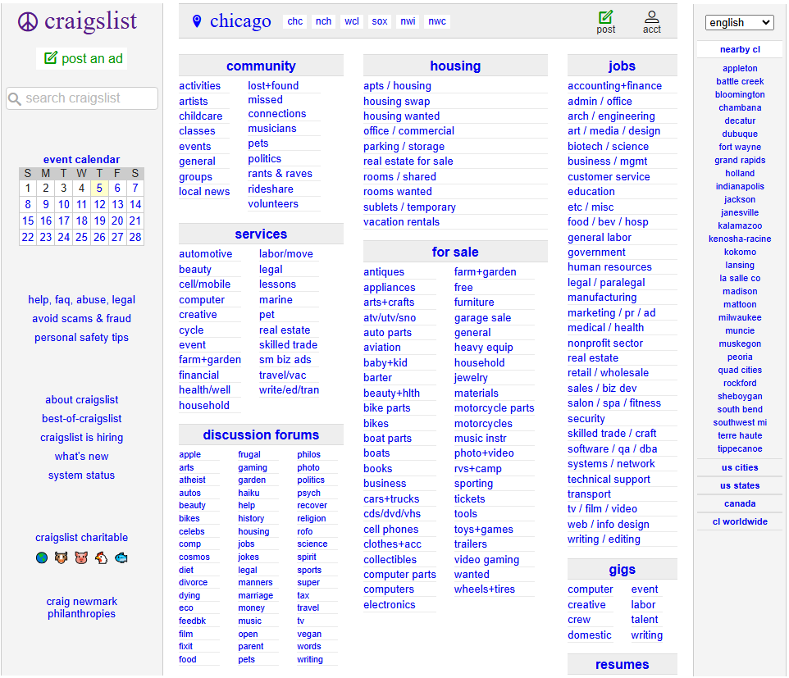

Slide 12
Better Handling of partial matches for searching.

Slide 13
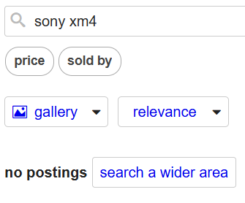
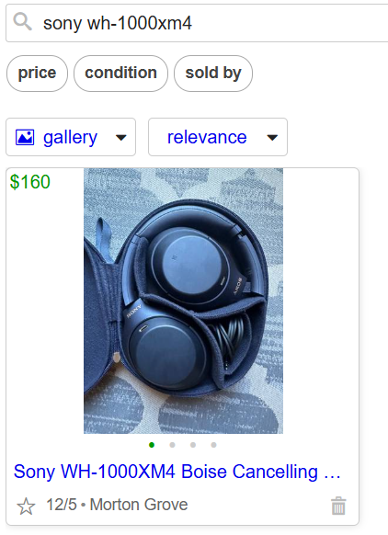
EX:
VS
The exact name of product:
Typing “sony xm4”

Slide 14
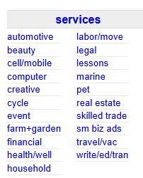
Make sections with content be collapsible.

Slide 15
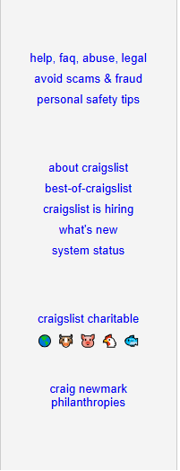

Perhaps add a feedback section in the white space areas for users.
feedback
feedback
feedback

Slide 16
Change the font of entire page to a more readable font.
Current font:
Better font:
"Open Sans" ,"Helvetica", "Arial", sans-serif”
"Roboto", sans-serif

